Slide 1
Spatial Relationship between Environmental Justice and Tier II Facilities in Massachusetts
Chengming Zhou & Mina Wei
ID 296 Advanced Vector GIS

Slide 2
Introduction
We wanted to understand the relationship between the Social Vulnerability Index (SVI) and Environmental Justice Districts
To examine the geospatial correlation between environmental justice areas and secondary facilities in Massachusetts.
To examine whether society tends to locate pollution sources near socially vulnerable groups
Notes:
SVI is a comprehensive composite index obtained by linear combination of several principal components from principal component analysis of several selected SVI variables, which quantifies the relative level of overall social vulnerability.
The populations of environmental justice areas are relatively disadvantaged in society, consisting of low-income, minority, and English as a second language population. Because they are in a socially invisible position, their rights may be violated without their awareness. This study wants to understand whether society prefers to locate pollution sources near socially disadvantaged groups. And which effects of environmental pollution people receive in environmental justice areas. We can use past data, research, and fieldwork to analyze the affected groups.

Slide 3
Research Question
1. The clustering of environmental justice populations is explored through standardized SVI indicators.
2. By demonstrating the spatial relationships of Tier II Facilities, the potential negative impacts on climate justice groups are explored.

Slide 4
Data
SVI data from the Agency of Toxic Substances and Disease Registry
Climate Justice Population map from the MassGIS (the state’s one-stop-shop for interactive maps and associated descriptive information)
Feature map of Tier II Facilities from the Massachusetts Executive Office of Energy and Environmental Affairs

Slide 5
Methodology
The variables were standardized according to four different classification criteria (Socioeconomic Status, Household Composition, Race/Ethnicity/Language, Housing/Transportation) to obtain the corresponding SVIs, and aggregation analysis was performed with GeoDa.
Using Kernel Density, Optimized Hot Spot Analysis and Optimized Outlier Analysis in ArcGIS pro, the Tier II Facilities (point features) were analyzed using ArcGIS Pro to explore their aggregation and compare them to existing environmental justice population maps.

Slide 6
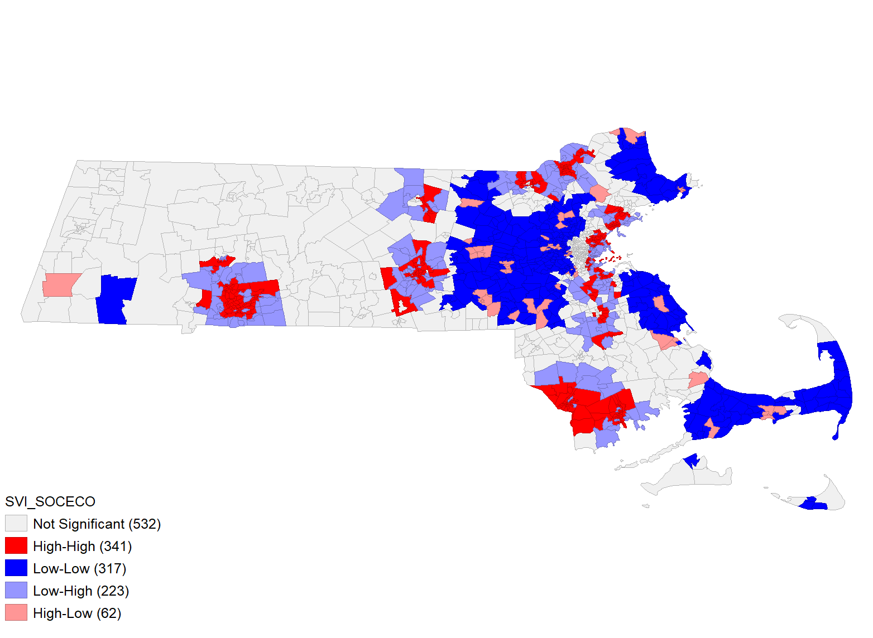
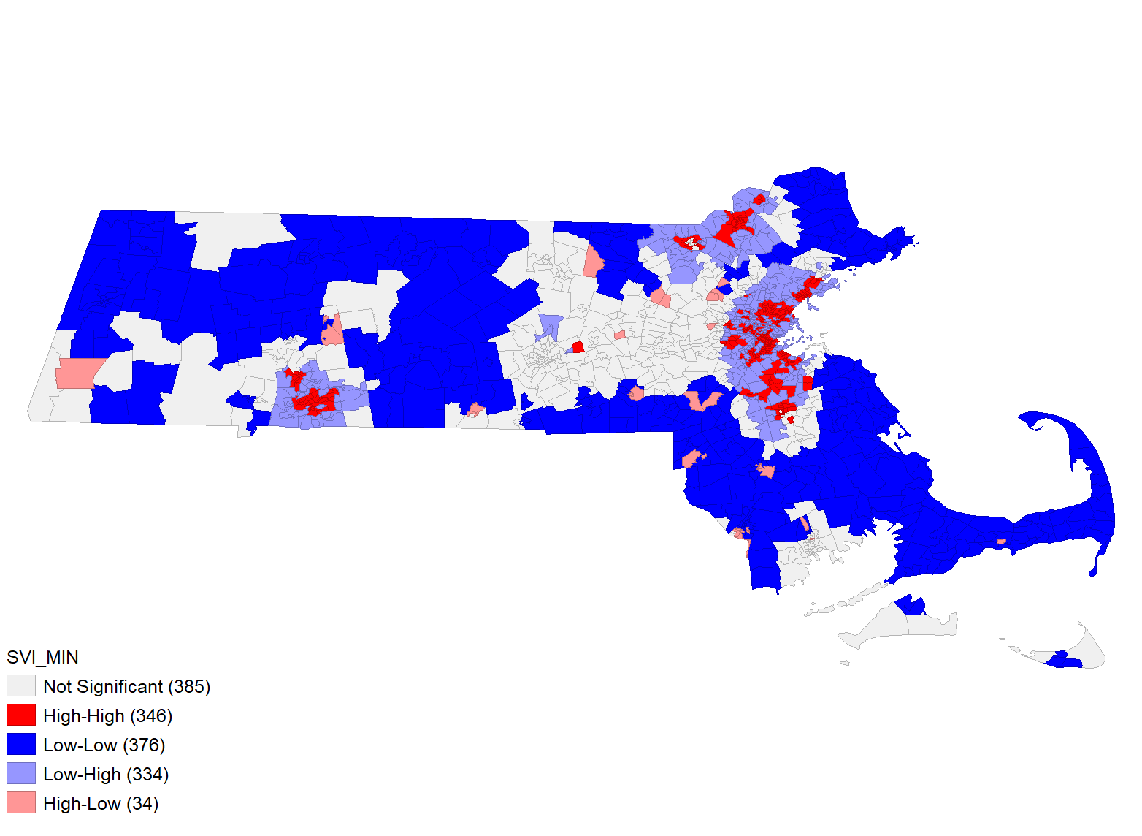
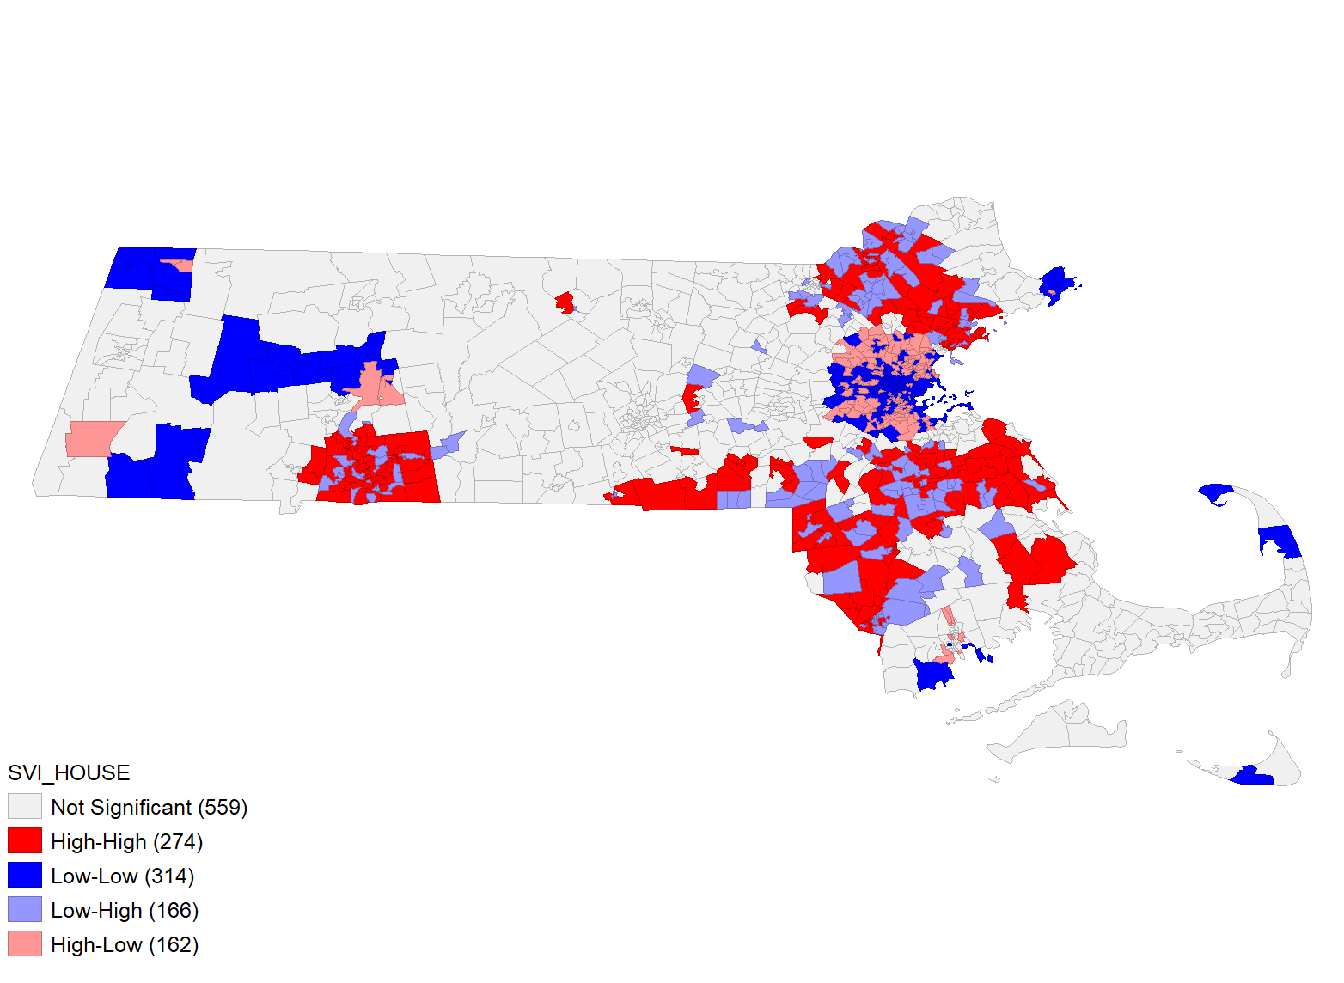
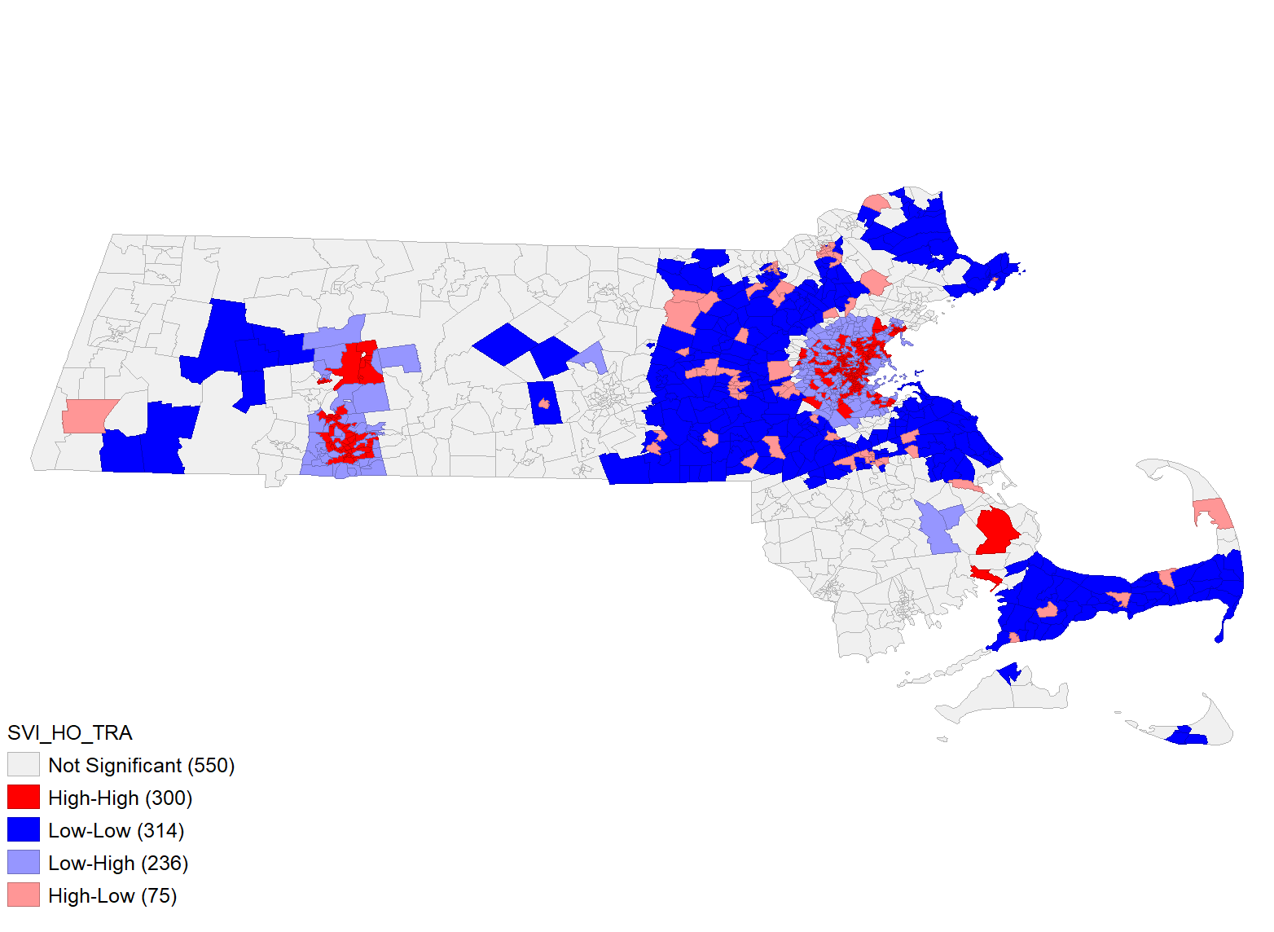
Result (SVI cluster map)
Socioeconomic Status
Moran’s I = 0.157
Minority Status & Language
Moran’s I = 0.201
Household composition & Disability
Moran’s I = 0.112
Housing Type & Transportation
Moran’s I = 0.117
Notes:
We used Geoda to create these maps, HH show on red color, means High feature surrounded by high neighbor.
Socioeconomic Status: Below Poverty, Unemployed, Low Income and No High School Diploma
Household Composition & Disability: Aged 65 or Older, Aged 17 or Younger, Civilian with a Disability, Single-Parent Households
Minority Status & Language include Minority, Aged 5 or Older who Speaks English “Less than Well”
Housing Type & Transportation: Multi-Unit Structures, Mobile Homes, Crowding, No transportation and Group Quarters
All the plots show linear fits through the point, cloud with the slope of this line corresponding to Moran's I. I consider Moran I to be statistically significant. When the Moran index is greater than zero, it is positively correlated, indicating that objects with similar attributes are clustered together.
All four maps show that the most socially vulnerable people in Massachusetts are clustered in Springfield, followed by the Boston neighborhood. People of similar ethnicity are more likely to cluster together, so the Minority Status & Language cluster map presents the best clustering.

Slide 7
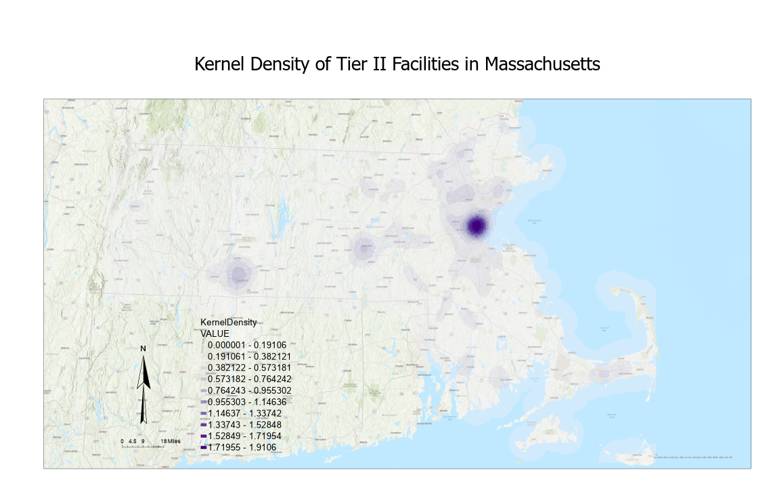
Result
Percentage of Tier II Facilities in Environmental Justice Group Areas
1841/4341= 42.4%
High Density: Boston, Springfield, Worcester, Barnstable.
Notes:
Left：MassGIS provide the existing climate justice group map presented in terms of income, English proficiency and minority. Within this region, Tier II facilities account for 42.4% of the total.
The kernel density map shows the density of Tier II facilities in their surrounding neighborhoods, thus we can find high densities in the Boston, Springfield, Wrocester, and Barnstable neighborhoods.

Slide 8
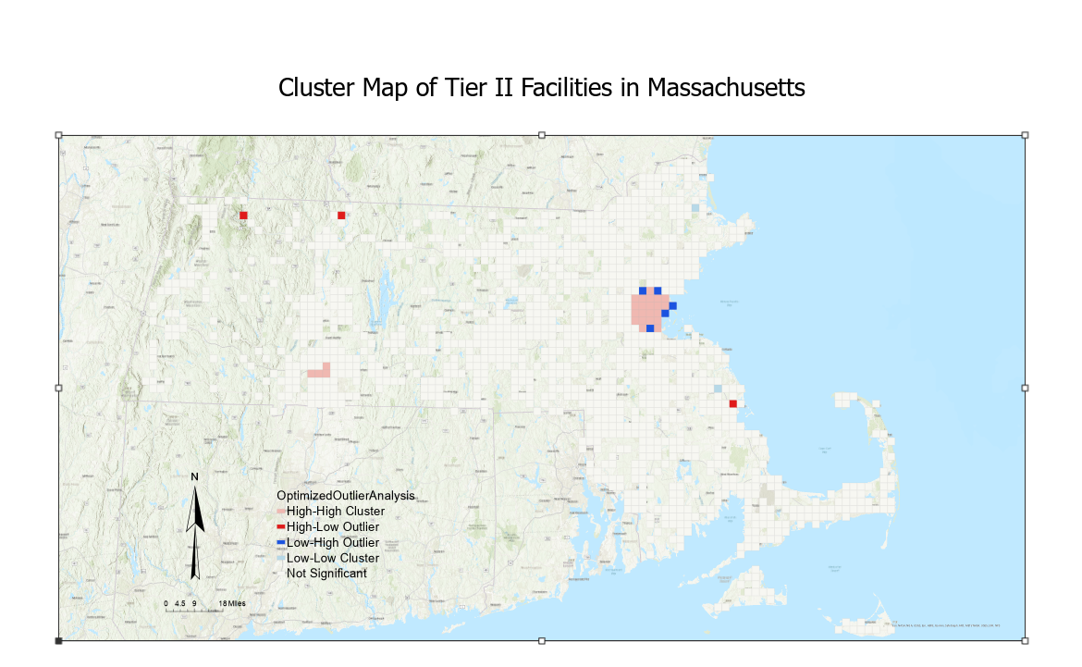
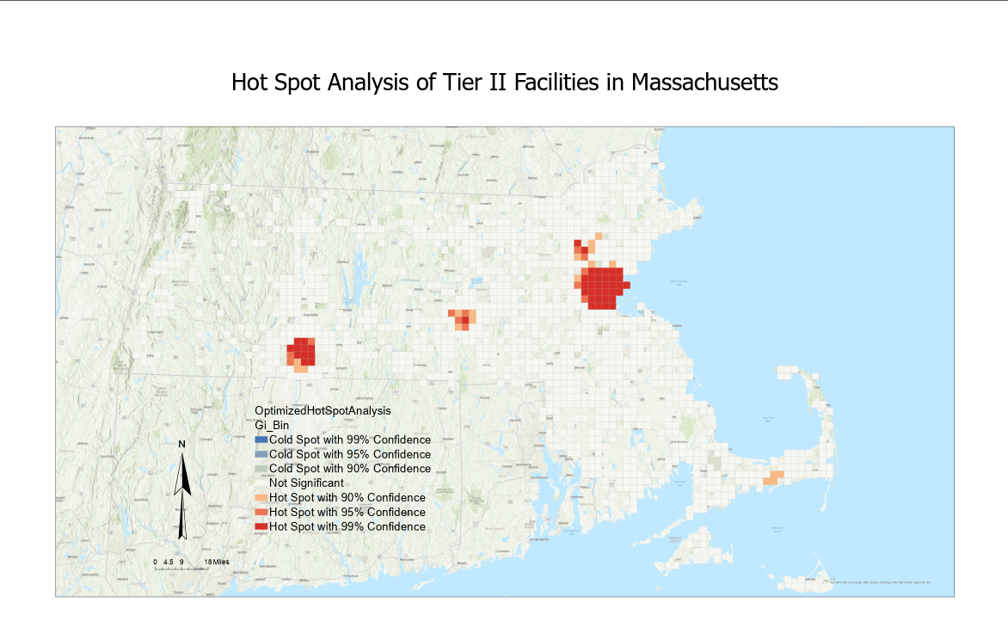
Result
Cluster: Boston, Springfield
Statistical Significance: Boston, Springfield, Worcester
Notes:
To improve accuracy, we used 999 permutations, and the optimized outlier analysis showed that the most aggregated regions remained Boston, showing extremely strong HH cluster， and Springfield also has some HH aggregation areas. The optimized hotspot analysis then shows that still shows great statistical significance in the Boston region, followed by the Springfield and Worcester regions, with Barnstable showing a small amount.

Slide 9
Conclusion
Through SVI's cluster maps, the other three maps excluding Household composition & Disability show similar areas of vulnerability clustering, i.e., Boston as well as the Springfield neighborhood, like the positioning of environmental justice groups
Spatial analysis reveals that there is a large overlap between the Tier II Facilities cluster and the environmental justice community area, which may involve economic and political factors

